Slide 1
SIRC of ICAI One day programme on Audit and Ethics
Dec 11,2024 CA. S Ramesh, FCA, DISA (ICA)

Slide 2
Professional ethics Essential Provisions for Chartered Accountants in Practice

Slide 3
COVERAGE
Chartered Accountants Act 1949
Misconduct - Definition
Schedules to CA Act - Differences
Clause 7 of part 1 of second schedule
What is Ethics
Disciplinary Cases – Procedures
Recent Developments & Cases
Certifications – Due Care

Slide 4
THE CHARTERED ACCOUNTANTS ACT, 1949
Description | Numbers | Sections/Parts
Chapters | 8 | 32
Schedules | 2 | 7
Appendices | 34 | -

Slide 5
CHAPTER V – MISCONDUCT Section – 22 Professional or other misconduct defined
For the purposes of this Act, the expression “professional or other misconduct” shall be deemed to include any act or omission, on the part of any member of the Institute either in his individual capacity or as partner or owner of a firm, as mentioned in any of the Schedules,
but nothing in this section shall be construed to limit or abridge in any way the power conferred or duty cast on the Director (Discipline) under sub-section (1) of section 21 to inquire into the conduct of such member or firm, under any other circumstances.

Slide 6
SCHEDULES

Slide 7
Why 2 Schedules
Where the Director (Discipline) is of the opinion that a member is guilty of any professional or other misconduct mentioned in the First Schedule, he shall place the matter before the Board of Discipline.
where the Director (Discipline) is of the opinion that a member is guilty of any professional or other misconduct mentioned in the Second Schedule or in both the Schedules, he shall place the matter before the Disciplinary Committee.

Slide 8
Why Key difference between the 2 Schedules
First Schedule focuses on professional etiquette, procedural compliance, and ethical practices.
Misconducts here may not always have a severe financial or reputational impact.
Second Schedule is focused on actions with potentially grave consequences, such as fraud, gross negligence, or deliberate malpractice

Slide 9
Part - I of First Schedule Professional Misconduct in relation to Chartered Accountants in practice
Clause (1): Allowing Non CA to practice in his name.
Clause (2): Sharing Fees or Profits with Non CA.
Clause (3): sharing any part of the profits of the professional work of a person who is not a CA
Clause (4): Entering in Partnership with Persons other than CAs in practice
Clause (5): Securing Professional Business by non-permitted means
Clause (6): Solicitation of Professional Work

Slide 10
Part - I of First Schedule Professional Misconduct in relation to Chartered Accountants in practice
Clause (7): Advertisement of Professional and Other Achievements
Clause (8): Non Communication with Previous Auditor
Clause (9): Accepting Audit Appointment without ascertaining Company Law compliance
Clause (10): Charging Fees on the basis of Percentage or Contingencies
Clause (11): Engaging business/occupation other than CA
Clause (12): Allowing Persons other than practicing CA to sign on his behalf

Slide 11
Part - Iii of First Schedule Professional misconduct in relation to members of the institute generally
Clause 1: Not being a fellow of the Institute, acts as a fellow
Clause 2: Does not supply the information called for or comply with requirements
Clause 3: Gives false information while inviting professional work

Slide 12
Part - Iii of First Schedule Professional mPART IV Other misconduct in relation to members of the Institute generallyconduct in relation to members of the institute generally
(1) is held guilty by any civil or criminal court for an offence which is punishable with
imprisonment for a term not exceeding six
months;
(2) in the opinion of the Council, brings disrepute to the profession or the Institute as a result of his action whether or not related to his
professional work.

Slide 13
Professional misconduct in relation to chartered accountants in practice
Clause (1): Disclosure of information without consent of Client
Clause (2): Submitting Report without verification of Financial Statements
Clause (3): Certifying Estimated Earnings
Clause (4): Audit of Concern in which having substantial interest
Clause (5): Failure to disclose material facts
Clause (6): Failure to report material misstatement
Clause (7): Grossly Negligent
Clause (8): Failure to obtain sufficient information
Clause (9): Failure to report material departures in accounts
Clause (10): Failure to keep client's money in separate A/c or using the same for it's purpose
Part - I of Second Schedule

Slide 14
Clause (7) of Part I of Second schedule
A CA in practice shall be deemed to be guilty of professional misconduct, if he does not exercise due diligence, or is grossly negligent in the conduct of his professional duties;
Though very simply worded, it is a vital clause
In discharging his professional responsibilities it is expected that he would exercise a reasonable degree of diligence in his professional assignment.
The member should also act diligently in accordance with applicable technical and professional standards.

Slide 15
Gross Negligence
Gross negligence implies a significant departure from the standard of care expected of a Chartered Accountant. It involves not just a simple mistake or oversight but a blatant disregard for established standards, rules, or procedures, leading to serious consequences.
Key Elements of Clause 7:
Gross Negligence: This is more serious than ordinary negligence and suggests reckless behavior or a willful lack of care.
Professional Duties: This clause applies to situations where the Chartered Accountant is performing professional responsibilities, such as auditing, accounting, or financial reporting.

Slide 16
Examples of Gross Negligence
Failure to Verify Key Information:
An auditor issues a clean audit report without verifying the existence of significant assets, leading to stakeholders making decisions based on incorrect financial statements.
Example: Certifying the value of inventory without performing any physical verification or examining inventory records.
Ignoring Red Flags:
A Chartered Accountant overlooks clear evidence of fraud or manipulation in the financial records of a client.
Example: Ignoring unusually large cash withdrawals or journal entries that clearly indicate fraudulent transactions

Slide 17
Examples of Gross Negligence – Contd..
Non-compliance with Accounting or Auditing Standards:
Not following mandatory standards prescribed by the ICAI or regulatory authorities.
Example: Failing to assess going concern assumptions during an audit, resulting in the misrepresentation of a company's financial health.
Improper Use of Audit Reports:
Issuing an audit report without completing the required procedures or obtaining sufficient evidence.
Example: Signing off on financial statements that were never reviewed or audited.

Slide 18
Examples of Gross Negligence – Contd..
Lack of Documentation:
Failure to maintain proper working papers or audit documentation, making it impossible to justify professional decisions.
Example: Not documenting key judgments in an audit file, such as materiality thresholds or the basis for sampling

Slide 19
Part - II of second Schedule Professional Misconduct in relation to members of the institute generally
(1) contravenes any of the provisions of this Act/regulations/guidelines1 issued by the Council;
(2) being an employee discloses confidential information acquired in the course of employment (except when required by any law)
(3) includes in any information, statement, return or form to be submitted to the Institute any particulars knowing them to be false;
(4) defalcates or embezzles moneys received in his professional capacity.
(5) acts as an auditor of the company in contravention of the provisions of the Companies Act, 2013

Slide 20
Part - III of second Schedule Other misconduct in relation to members of the Institute generally
A member of the Institute, whether in practice or not, shall be deemed to be guilty of other misconduct, if he is held guilty by any civil or criminal court for an offence which is punishable with imprisonment for a term exceeding six months

Slide 21
Ethics refers to the set of moral principles, values, and standards that guide individuals and groups in determining what is right and wrong in their behavior and decision-making.
Key Aspects of Ethics:
Morality: Ethics is closely related to morality, which concerns the principles of right and wrong. Ethics gives a structure to how these moral principles are applied in real-world situations.
Integrity: Acting in an honest and transparent manner, even when it is not convenient or when no one is watching.
Fairness: Ensuring that decisions are made impartially and justly, without favoritism or bias.
Responsibility: Being accountable for one’s actions and decisions, especially in the context of the impact they may have on others.
5. Respect for Others: Recognizing and valuing the rights, dignity, and autonomy of other individuals or groups.
What is Ethics

Slide 22
Ethics
ஒழுக்கத்தின் ஒல்கார் உரவோர் இழுக்கத்தின் ஏதம் படுபாக் கறிந்து
The strong of mind will not shrink from virtue for they know that any deviation is wrought with dire consequences.
அறன்ஈனும் இன்பமும் ஈனும் திறனறிந்து தீதின்றி வந்த பொருள்
The wealth acquired with a knowledge of the proper means and without foul practices will yield virtue and happiness.

Slide 23
----- Word of caution !!!!
History shows that where ethics and economics come in conflict, victory is always with economics.
Vested interests have never been known to have willingly divested themselves unless there was sufficient force to compel them. B. R. Ambedkar
Hence the need for COE
ETHICS
ECONOMICS

Slide 24
WHY THIS NEW CODE OF ETHICS
Members have domestic as well as International Practice. Hence have to be aligned with International developments .
Hence this new code of ethics.
The New Code is applicable from 1st April 2020
ICAI CoE converged with latest edition of IESBA Code of Ethics
While the revised code retains the fundamental ethical principle from the earlier code, it covers a refreshed approach and revised requirement.

Slide 25
ICAI Code of Ethics 2019
- New Requirements – a Recap
More a refresher

Slide 26
New Requirements
Long Association of personnel (Section 540)
Non-assurance services to Audit client (Section 600)
Key Audit Partner (in the context of partner rotation)
- The engagement partner, the individual responsible for the engagement quality control review, and other audit partners, if any, on the engagement team who make key decisions or judgments on significant matters with respect to the audit of the financial statements on which the firm will express an opinion

Slide 27
New Requirements
“Relative” as defined under the Companies Act, 2013 are reckoned if the client is a company while “immediate family” and “close family” are reckoned in case of other clients.
- Immediate Family: A spouse (or equivalent) or dependent
- Close Family: A parent, child or sibling who is not an immediate family member
Responding to Non-Compliance of Laws and Regulations (NOCLAR).
- In 2019 Code, it has been initially made applicable to Auditors/Employees of Listed entities in India.

Slide 28
New Requirements
Management Responsibilities
Requirement restricting audit team members and Key Audit Partners from being compensated for providing non-assurance services to audit clients.
Requirements and applicable guidance addressing situations where, as a result of a merger or acquisition, an entity becomes a related entity of an audit client, to assist the Chartered Accountant in evaluating previous or current interests and relationships
Provisions relating to threats that are created by certain tax services

Slide 29
New Requirements
Requirement where the total gross annual professional fees from the audit client and its related entities exceed 15% of the total fees of the firm for two consecutive years.
Detailed independence requirements included for assurance engagements.
Auditor rotation requirements included under various local regulations
In essence self review, self advocacy and conflict of interest are the main focus.

Slide 30
Purpose & objectives ?!
TO OVER COME AND MITIGATE THE THREATS……

Slide 32
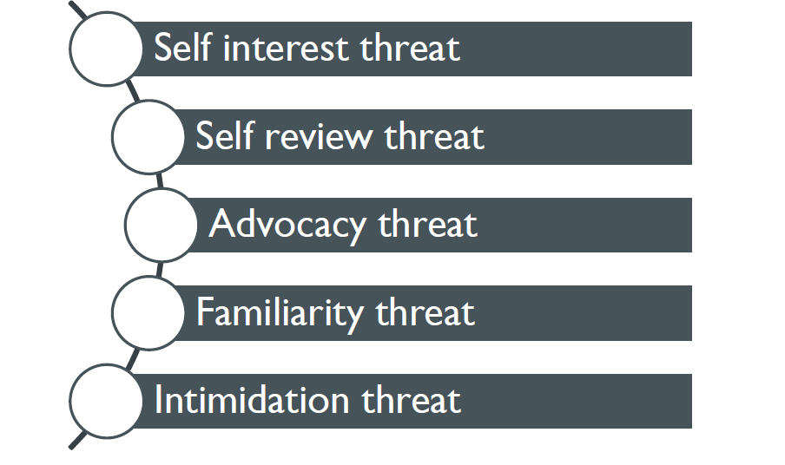
Ethical Requirements-Threats
Firm should identify, assess and apply appropriate safeguards to eliminate or reduce the risk from threats
If threats are not eliminated or reduced firm must consider withdrawing from the assignement

Slide 33
THREATS
Self Interest Threats
Direct FI in a client
Quoting a low fee to obtain a new engagement
Close business relationship with client
Self-review threats
Issuing assurance report on effectiveness of operation of financial systems, after self implementing the above-mentioned systems
Prepared original data used to generate records that are the subject matter of assurance engagement
Advocacy threats
Access to confidential information that might be used for personal gain
Promoting the interests of a client
Lobbying in favor of legislation on behalf of a client.

Slide 34
THREATS
Familiarity Threat
Close / immediate family member who is a Director or officer of the client
Long association with the audit client.
Intimidation Threat
Threatened with dismissal from a client engagement or the firm, because of a disagreement about a professional matter
Pressured to agree with the judgment of a client
Accepted a significant gift from a client and being threatened that acceptance of this gift will be made public

Slide 35
Safeguards against the Threats
Safeguards created by the profession, legislation or
regulation include, but are not restricted to:
(a) Educational, training and experience requirements for entry into the profession.
(b) Continuing professional development requirements.
(c) Corporate governance regulations.
(d) Professional standards.
(e) Professional or regulatory monitoring and disciplinary procedures.
(f) External review by a legally empowered third party of the reports, returns, communications or information produced by a professional accountant.
14

Slide 36
Safeguards in the work environment:
> Compliance with the fundamental principles.
> Act in the public interest.
> To implement and monitor quality control of engagements.
> Identification and the application of safeguards.
> For assurance engagements - documented independence policies.
> To monitor and manage the reliance on revenue received from a single client.
> For Using different partners and engagement teams with separate reporting lines
> Timely communication of a firm's policies and procedures, including any changes to them, to all partners and professional staff, and appropriate training and education on such policies and procedures.
> Designating a member of senior management to be responsible for overseeing the adequate functioning of the firm's quality control system.
> Advising partners and professional staff of those assurance clients and related entities from which they must be independent.
> A disciplinary mechanism to promote compliance with policies and procedures.
> Published policies and procedures to encourage and empower staff to communicate to senior levels within the firm any issue relating to compliance with the fundamental principles that concerns them.
15

Slide 37
Engagement- specific safeguards in the work environment
> Involving an additional professional accountant to review the work done or otherwise advise as necessary.
> Consulting an independent third party, such as a committee of independent directors, a professional regulatory body or another professional accountant.
> Discussing ethical issues with those charged with governance of the client.
> Disclosing to those charged with governance of the client the nature of services provided and extent of fees charged.
> Rotating senior assurance team personnel.
16

Slide 38
Reduce Threats
Accept
Threat
Evaluation
Decline
Not Possible to reduce Threats
17

Slide 39
Application of Conceptual Framework
□ Professional Appointment
> Client Acceptance - Council Guidelines on KYC for Clients.
> Engagement Acceptance - Whether engagement can be accepted?
> Changes in a Professional Appointment - Communication with previous Auditors.
□ Conflicts of Interest Second Opinions
□ Fees and Other Types of Remuneration
□ Marketing Professional Services
□ Gifts and Hospitality
□ Custody of Client Assets
18

Slide 40
Precaution - Ineligible Services
accounting and book keeping services;
internal audit;
design and implementation of any financial information system;
actuarial services;
investment advisory services;
investment banking services;
rendering of outsourced financial services;
management services; and
any other kind of services as may be prescribed

Slide 41
ILFS - Other services – Audit Committee Approval Not obtained - Staff rotation & familiarity threats

Slide 42
Developments @ ICAI
It may further be noted that the Council at its 393rd Meeting held on 30th June to 1st July, 2020 has decided that due to the prevailing situation due to Covid-19, the following provisions of Volume-I of Code of Ethics, 2020 be deferred till further notification :-
1. Responding to Non-Compliance of Laws and Regulations (NOCLAR) [Sections 260 and 360]
2. Fees - Relative Size [Paragraphs 410.3 to R410.6]
(Further clarified that no prohibition – but communication to those in charge of governance & disclose) 3. Taxation Services to Audit Clients [Subsection 604] With the exception of aforesaid provisions, all other provisions of revised Code of Ethics are applicable w.e.f 1st July, 2020.

Slide 43
Developments @ ICAI
Communication to Previous Auditor – Can be by Email
Projections may be signed – Follow SAE 3400
Provisional Statements – Signature can be on compilation – SRS 4410 – Different from Limited Review statements
Decisions by Ethical Standards Board
FAQs by ICAI

Slide 44
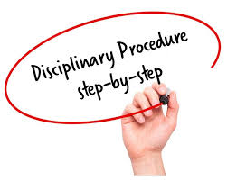

Slide 45
Process
A complaint is filed in form I, under section 21 of CA Act 1949..
Where the Director (Discipline) is of the opinion that a member is guilty of any professional or other misconduct mentioned
* in the First Schedule, he shall place the matter before the Board of Discipline under sec 21A and
* in the Second Schedule or
in both the Schedules, he shall place the matter before the Disciplinary Committee u/s.21B.

Slide 46
Who can file
Users of audit reports/certificates
Others
Banks & financial Institutions
Audits
Projections
Other matter
Investigation authorities
Companies / Firm/other entities
Central / State Governments
Statutory authority
RBI
SEBI
MCA
Fellow brethren
Client and part thereon
Others ??
Information

Slide 47
Withdrawal
Where a complainant withdraws the complaint :
Director shall place it before :
the Board of Discipline or,
the Disciplinary Committee, … as the case may be
May permit the withdrawal
Opportunity to be heard is paramount and before any orders

Slide 48
Registration of complaint
Every complaint is acknowledged
Scrutiny and then a unique number allotted
Prima facie opinion
Previous complaint, pending – then clubbed
If defects are not rectified, the director SHALL form opinion thet there is no Prima facie case

Slide 49
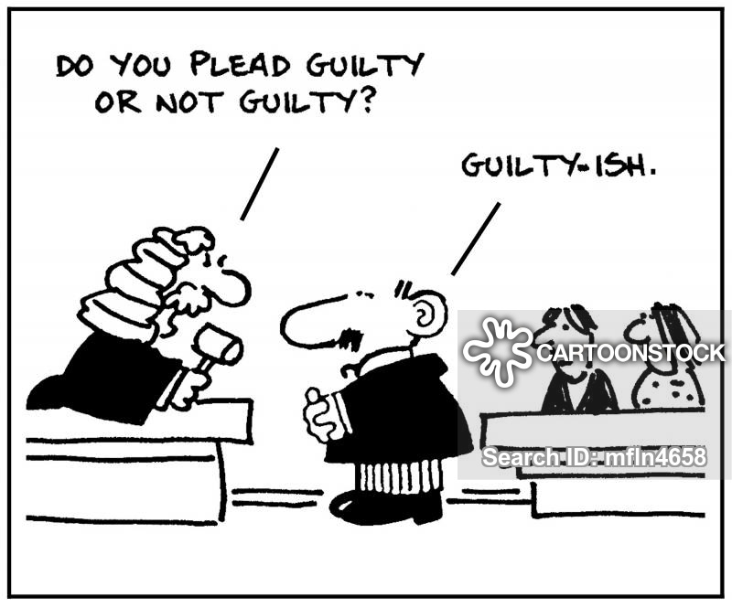
Examination by director
Complaint
Written statement
Rejoinders
Other additional particulars / documents
Prima Facie
Board of discipline may or may not agree ……….
Further investigation if necessary
Damage happens here!

Slide 50
Typical answers which lead to GUILTY verdict:
I am really sorry
The error is not intended
I was only x years in profession
I will not repeat the same mistake
Forgive me
What to do
The mother body / institute ………..
And the worst of all ………………. Not replying ..

Slide 51
Recent Developments
Notice – RPAD, Email ……….. Whatsup ( Covid 19 effect)
All hearings by Video Conferencing
Either at ICAI premises or from member office or counsel office – Option to be exercised in writing
Written submissions well in advance – Both by email and by post

Slide 52
Approach of members
One of casualness
One of over confidence
One of fear
One of Knowing all
One of dealing the issue from a wrong angle
Self Medication ?! Dangerous
Remedies ………………. ????

Slide 53
Result
Finding guilty – strike off from the rolls for x months, y years
Reprimand – is also guilty only
Fine
Fine and strike off
Exonerated
Repercussions – on Bank audit , empanelment forms

Slide 54
Further remedies of found guilty ….
Appellate authority
High court
Supreme court

Slide 55
Action Trigger Point – for DC cases
Bank scams,
Projections
Audits
Computerised audits
CBI, Enforcement raids
Black Money angle
Benami Transactions
Records in Auditor’s place
Sign – Forged
Tax audit not signed
RBI – NBFC inspection points
DSC
Records
Documents

Slide 56
Recent Issue – which can trigger DC
Bank Branch Audits
LFAR issues
Manual vs automatic data updation
Quantitative reporting of advances verified – Both Standard and others
Manual intervention in IRAC norms
NPAs of earlier years identified in current year
Potential NPAs and Quick mortality
Lots of assertion and commitments – Like Stock audit/ratings/due diligence
Operations verification – Large accounts
Management Representations
Multiple UDINs vs Two UDIN as stipulated by ICAI
Revision of MOC – resulting in revised audit report – New UDIN & reference of previous audit report also to be given

Slide 57
Recent Cases of DC
Mainly from Bank Issues & frauds
Complaints by CBI
Complaints by CB – CID of various states
Generated out of various certifications and reports of auditors
Complaints from the Tax Departments on wrong claims or representations
Complaints from enforcement authorities
Other complaints from clients’ creditors
Other complaints from partners / trustees
Other complaints from Professional brethren

Slide 58
Few Recent Cases
Member signed Financial Statements of a Society
Complaint by a group of members
Expenditure disproportionately increased not verified
Ultimately it is found as fraudulent expenses
Auditor himself did investigation and committed as fraudulent expenses
Documentations insufficient
Internal Audit reports and monthly certifications are not sufficient
Management Certifications not sufficient
Statutory auditor should exercise due diligence

Slide 59
Few Recent Cases – contd.
Member Certified for Bank Loan
Complaint by the Bank on
Wrong certificate of book debts
Wrong certificate of capital infusion
Auditor also doing bank fund arrangement
Books of accounts not available for defence
Capital infusion was by way of book entries
Self Review Threat was blatantly violated
Statutory auditor should exercise due diligence

Slide 60
Few Recent Cases –contd.
Member Certified Assets & Liabilities
Complaint by the Bank on
Inflated value of security
Collusion with the management
Audited financials have inflated capital
Auditor depended on Valuation report which is inflated than the cost on a recent purchase
Proprietor Assets and liabilities are stated without due verification
Statutory auditor should exercise due diligence

Slide 61
Few Recent Cases – contd.
Concurrent Auditor not verified securities
Complaint by the Bank on
Bogus Securities
Units not inspected sufficiently
Collusion with the branch management
Auditor depended on Valuation report & appraisers
Auditor depended on terms of reference
Concurrent auditor should be more careful and exercise due diligence & periodically verify the securities and appraise with third branch appraiser

Slide 62
Few Recent Cases – contd.
Member Certified Balance Sheet with wrong figures
Complaint by one of the Creditor
Contingent Liaiblity not disclosed
MSME dues not disclosed
Creditor figure misstated
Auditor violated the provisions of ICAI by doing assignment
Legal case not known to auditors
MRL taken – but DC considers not sufficient
One assignment done in march and audit taken up in august considered violation
Statutory auditor should examine Self advocacy/review threats before taking up audit

Slide 63
Few Recent Cases – contd.
Member Certified Balance Sheet with wrong figures
Complaint by CBI on account of Corporate Fraud
Inflated Debtors & Assets
Collusion with the management creating Loss to banks & FIs
Dual Accounts purportedly maintained by the Client
Auditor verified the records but sampling not sufficient
Documentation not sufficient to prove diligence
Dependence on Internal audit not fully sufficient
Statutory auditor should exercise due diligence/document the same concurrently during audit.

Slide 64
Take Home Message
COE or DC is not only for High End audits like ILFS or Satyam
Day to day certifications are raked up
Bank concurrent audits – Increasing Menace
Trusts and Societies – Disputes among members
And Now Bank Branch Audits can trigger – Lots of commitments by Branch Auditors

Slide 65
Due care while issuing certificates
Refer Certifications-Guidance Note by ICAI & SA 805
Critical Certificates issued by CAs
Certificates on the support of financial books of accounts and annual FS such as- Capital contribution, Gross t/o, S. Debtors & closing stock, statutory liabilities etc.
Certificates for foreign remittance outside India in form 15CB
Certification of Documents for Registration of Charges
Various Certificates needed by the Companies Planning for IPO
Certification under Exchange Control legislation for imports, remittances, ECB, DGFT,etc.
Certification for claim of refund under GST Act and other Indirect Taxes Certification of Fair Values of Shares of Company for the scope of merger/de-merger, Buy Back, Allotment of further shares and transfer of shares from resident to non-resident

Slide 66
Critical Certificates issued by Cas – Contd.
Certificates on the grounds of statutory records being maintained under Indian Companies Act, 2013 and other applicable laws.
Certification for Export Incentives and other benefits
Certification of Arms length price u/ 92 of the income Tax Act, 1961.
Utilization certificates of various grants being discharge by Govt. of India to NGO’s, Statutory Bodies, Autonomous Bodies, and charitable organizations.
Certificates for claiming various deductions & exemption under various rules & regulation.
Certification under the Income-Tax laws for various deductions and provisions, such as MAT, EOU, etc.

Slide 67
One Final Word …..
When not permitted …..
Do not accept / undertake
When in doubt …..
Do not accept / undertake
When Looks acceptable …..
Do Accept / undertake ---- With Professional Skepticism !!!

Slide 68
THANK YOU
S.ramesh
ramesh@srbr.in

